Slide 1
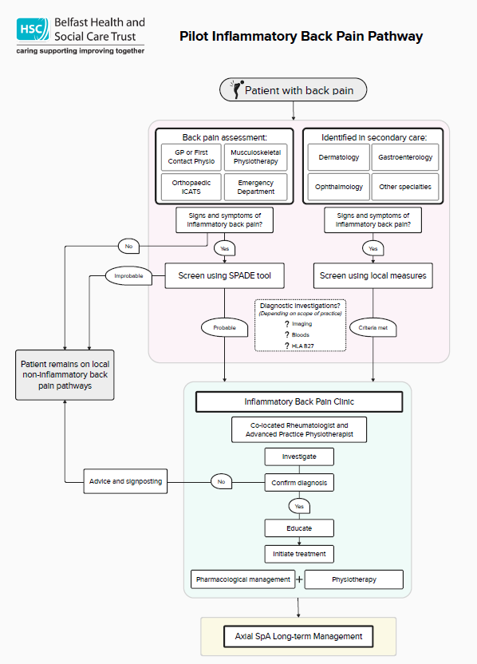
Delayed diagnosis of axial spondyloarthritis: A pilot to transform axial SpA services in Belfast and drive improvements in diagnosis and care
Joe Eddison, Niamh Kennedy, Dr Neil Heron, Dr Adrian Pendleton
BACKGROUND
The Belfast Trust rheumatology service caters to a population of 340,000 as well as accepting referrals from across Northern Ireland. Despite offering inpatient, outpatient, and day-case management for rheumatological conditions, there is a deficiency in specialised services and variable access to crucial resources such as aquatic physiotherapy.
The average delay to diagnosis of axial SpA in the Belfast Health & Social Care Trust is in line with UK average. Whilst the average waiting times for rheumatology are currently 12 weeks for early inflammatory arthritis which mainly captures inflammatory polyarthritis such as Rheumatoid arthritis, the wait times are much longer, 90 weeks (1.7 years) for urgent referrals; and, 223 weeks (4.3 years) for routine referrals.
Within many parts of Belfast, similar to some other areas in the UK, patients with inflammatory back pain are typically referred to general musculoskeletal outpatient services. The lack of a dedicated axial SpA service exacerbates diagnostic delays underscoring the need for a defined inflammatory back pain pathway to improve diagnosis and treatment timelines for axial SpA patients.
OBJECTIVES
Primary: To achieve a sustainable reduction in the time to diagnosis of patients with Axial SpA in Belfast.
To increase the volume of patients seeking help for chronic back pain
To increase the number of referrals to rheumatology for suspected IBP
To improve the quality of referrals and increase the conversion of referral to assessment
To increase the number of patients receiving an axial SpA diagnosis
To improve the diagnostic conversion rate from referral to diagnosis
To reduce the time to diagnosis across the pathway including earlier seeking of help, reduced waiting times, speedier referral, and prompt diagnosis.
To reduce the number of repeat visits to primary care professionals prior to referral and diagnosis
To create higher confidence and awareness of axial SpA in PC HCPs
METHODS
The NASS Act on axial SpA campaign, in collaboration with the Belfast Health & Social Care Trust, seeks to streamline the patient journey from symptom onset to diagnosis. By increasing awareness of the condition, and integrating diagnostic improvements and specialist care pathways, the pilot aims to reduce time to diagnosis for axial SpA, serving as a model for broader implementation. See figure 1.
PATHWAY / CLINIC RESULTS (from the first 6 months of new clinic)
Total of 31 patients seen in clinic (68% female vs 32% male) with 27 or 87% of these were appropriate referrals to an IBP clinic
Main route to referral was from primary care (88%), made up of 43% (13) from GPs, 26% (8) from FCPs, 13% (4) from Orthopaedic ICATs service and 6% (2) from Physiotherapists. The other sources were 2 from Dermatology, 1 from Cardiology and 1 from a Private Rheumatologist.
The average waiting time from referral to assessment has been 2 months and 11 days (or 71.7 days) compared to the Belfast published waiting times for urgent referrals being 1.7 years or 90 weeks.
This has resulted in:
7 confirmed axial SpA diagnosis – 23% conversion
4 likely (but unconfirmed pending imaging) axial SpA diagnosis – 13% conversion
4 Psoriatic Arthritis diagnosis – 13% conversion
So likely, a total of 15 patients with spondyloarthritis diagnoses and conversion rate of 48%.
The average time to diagnosis (from symptom onset) of the 7 confirmed axial SpA diagnosis is: mean of 7.37 (compared to a baseline of 8 pre pilot); median of 4, minimum of 6 months and maximum of 25 years.
CONCLUSION
By creating the conditions through our new dedicated inflammatory back pain clinic and pathway we created the foundations for improving patient experience and diagnosis times.
Then through educating the public and primary care professionals on the signs and symptoms, giving clarity on referral criteria and processes and having the dedicated capacity to assess appropriate patients we have started to transform our service. As shown in the significant reduction in waiting time to those with IBP.
Educating GPs helped to dispel some common myths around axial SpA and change their referral patterns, for example increasing clinical suspicion around females with chronic back pain and 12 patients referred despite being HLAB27 negative.
Whilst time to diagnosis has not initially significantly reduced this is in the main driven by patients who have been bouncing around primary care for years now being picked up and referred on to rheumatology for assessment. Once these patients are through the system we expect to see lower time to diagnosis over time as newer patients are identified and referred.
PRIMARY CARE EDUCATION RESULTS (based on February GPNI session)
A total of 167 primary care professionals (90% GPs) have viewed the education session (32 live / 135 recorded)
An average feedback rating of 9 out of 10 on the session overall and 4.7 out of 5 for speakers.
Scored 4.7 out of 5 for relevance of the event and 150 recommend the event for others.
Raising Awareness in Healthcare Professionals
Education sessions, targeting primary and secondary care professionals, aim to improve awareness and understanding of axial SpA. These sessions, conducted by the pilot team, including Dr. Neil Heron and Niamh Kennedy, equip healthcare professionals with the knowledge and tools necessary for early identification and referral of suspected axial SpA cases.
A New Inflammatory Back Pain (IBP) Pathway and Clinic
The Belfast Health & Social Care Trust has initiated a dedicated clinic for inflammatory back pain led by Dr. Adrian Pendleton. This monthly clinic, launched in November 2023, focuses on expedited assessment and management of new patient referrals, aligning with the newly implemented IBP pathway.
Improving Assessment Within Rheumatology
The new axial SpA clinic adopts a comprehensive approach to diagnosis, integrating clinical evaluation, laboratory tests, and advanced imaging techniques. By consolidating diagnostic information, the clinic facilitates timely and accurate diagnoses, enabling prompt initiation of appropriate treatment modalities.
Measuring Improvement
Key performance indicators, aligned with the patient journey and IBP pathway, will be utilised to measure the impact of the pilot project. These metrics include average time to diagnosis, average waiting times, referral volumes, and patient satisfaction.
Public
Awareness Work
New IBP pathway
Public Awareness
HCP education
Assessment in rheumatology
HCP education – Primary Care & Secondary Care
New Inflammatory Back Pain Clinic
Entry part of the pathway is the focus of the work in the pilot between Belfast and NASS
New Inflammatory Back Pain Clinic & Assessment in rheumatology
Measuring Improvement
Figure 1 – Graphic of the ‘integrated pilot’ across the pathway approach
Figure 2 – New Belfast Inflammatory Back Pain Pathway
Acknowledgments: Belfast Health & Social Care Trust (BHSCT) is working in partnership with the National Axial Spondyloarthritis Society (NASS) as part of the Act on axial SpA campaign which aims to reduce diagnostic delay in axial SpA. The partnership includes a public awareness campaign, primary care education and advice on clinical data. Act on Axial SpA is led by NASS in partnership with Norfolk & Norwich NHS Foundation Trust and RUH Bath NHS Foundation Trust. The programme is funded by UCB as sponsor of the project. UCB has no editorial influence over this project.
BHSCT are also working as part of a collaborative agreement with Abbvie, which covers the set up of the pilot specialist clinic in the trust, primary care education and the new inflammatory back pain pathway. BHSCT has rights around the data generated from this work and its use.

