Slide 1
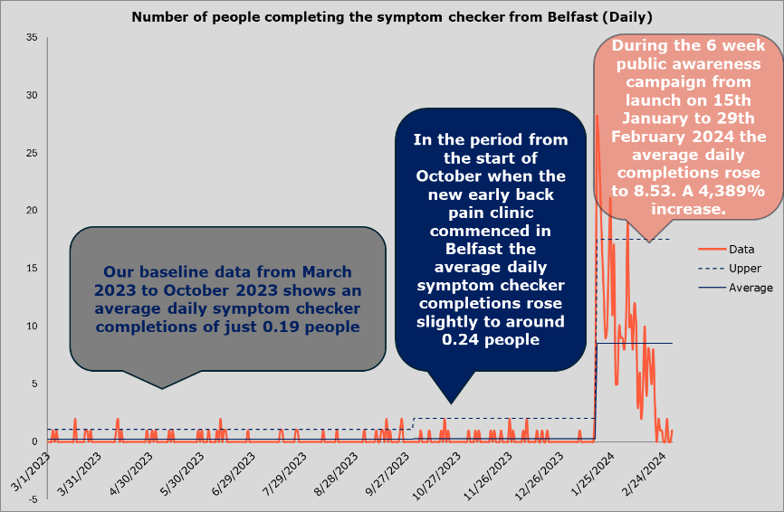
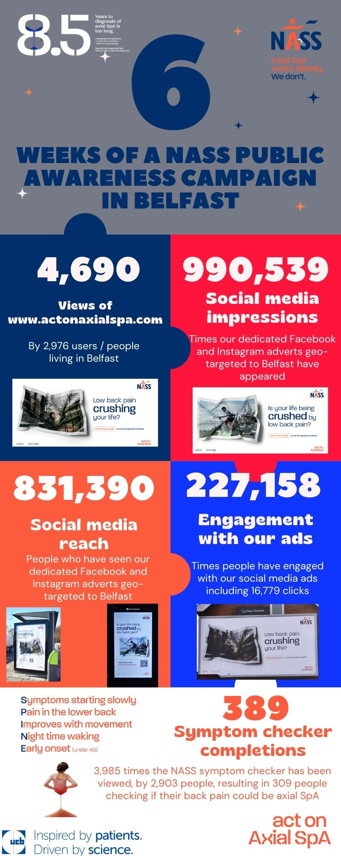
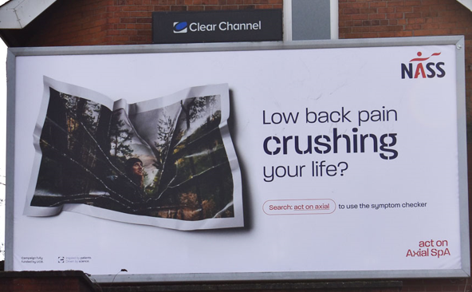
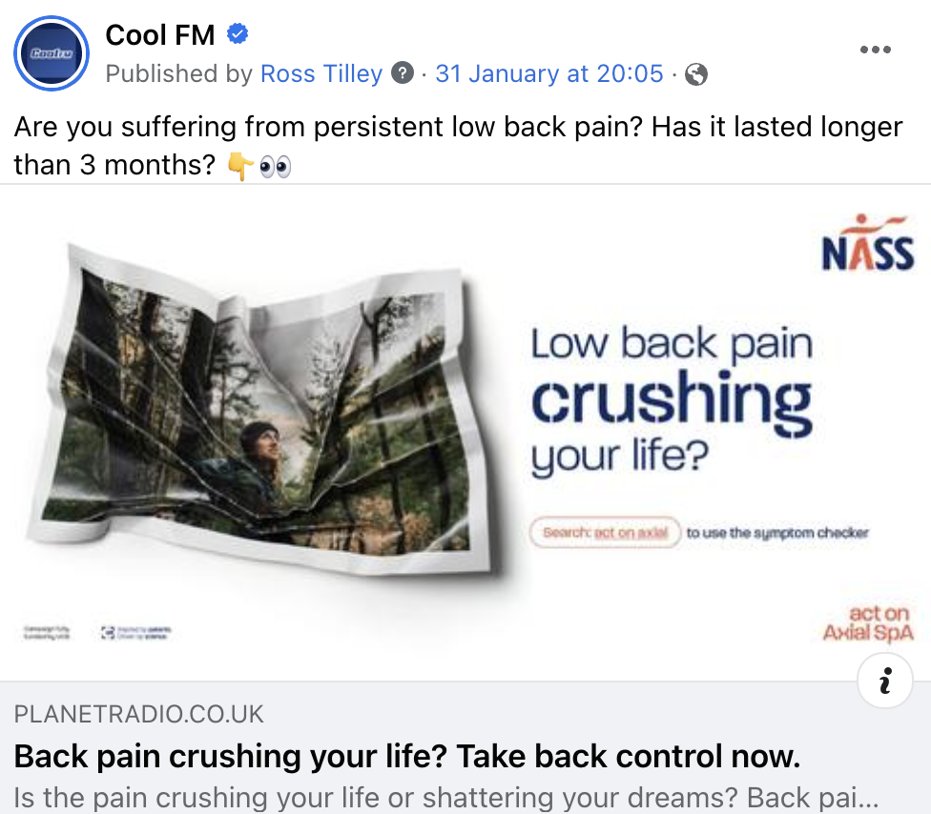
Increasing public awareness of axial Spondyloarthritis in Belfast through a multi-faceted public awareness campaign linked to transforming clinical services – As part of a place based integrated set of interventions
Joe Eddison, Niamh Kennedy, Dr Neil Heron, Dr Adrian Pendleton
BACKGROUND
The Act on Axial SpA campaign is dedicated to minimising the lengthy 8.5-year delay in diagnosing axial spondyloarthritis (axial SpA) by implementing a pioneering Gold Standard diagnosis time of just one year. Collaborating with the Belfast Health & Social Care Trust, our initiative aims to streamline the patient journey from symptom onset to diagnosis through a comprehensive, integrated intervention package. By enhancing awareness of axial SpA and optimising diagnostic procedures alongside specialist care pathways, our pilot project endeavours to abbreviate the time to diagnosis, thereby serving as a blueprint for broader implementation across healthcare systems.
OBJECTIVES
To increase awareness of axial SpA across Belfast
To utilise public awareness materials to reach and engage people in Belfast living with low back pain
To drive people living in Belfast with chronic low back pain to take the NASS symptom checker
To help patients understand their back pain could be axial SpA and seek help from primary care
To help patients start their journey to diagnosis and move through the pathway swiftly
METHODS
In partnership with a specialist Belfast-based creative agency, we devised a geo-targeted, multi-channel media campaign to bolster public awareness. Our strategy encompassed out-of-home advertising, radio promotions, and targeted social media adverts. The campaign featured 85 out-of-home advertising panels across 85 locations, radio slots on Cool FM, and geographically tailored social media adverts on Facebook and Instagram. Spanning six weeks during January and February 2024, we meticulously tracked the campaign's performance through standard social media and digital analytics platforms.
.
RESULTS
Our campaign resonated strongly with individuals experiencing low back pain, prompting them to take action by utilising the NASS symptom checker. Over the six-week period, our social media outreach amassed an impressive 995,399 impressions and reached 831,390 individuals. Out-of-home advertising achieved an 81% reach among 18–40-year-olds in Belfast, engaging over 88,000 individuals. Additionally, radio partnership adverts reached more than 565,000 adults across Northern Ireland. (See figure 2 below)
This extensive reach translated into robust engagement metrics:
Social media ads garnered 16,799 clicks and 227,158 engagements.
Radio advertising led to 2,390 readership engagements on Cool FM.
The Act on Axial SpA website witnessed a surge in traffic, with 2,976 users from Belfast visiting during the campaign, compared to 285 in the entirety of 2023.
Remarkably, the NASS symptom checker experienced a staggering 4,389% increase in average daily completions during the campaign. (See figure 1 below)
CONCLUSION
It was estimated that of these about 285 people (73%) met the threshold for being referred to rheumatology and we now track these referrals through clinic to understand the outcome and ultimately how many of these have been diagnosed with axial SpA.
Our findings demonstrate the efficacy of engaging individuals with longstanding low back pain through innovative, visually compelling marketing materials infused with public health messaging. Moreover, early clinical data suggests that heightened public awareness can be achieved without overwhelming the healthcare system, while expediting patients' journeys towards diagnosis. By continuing to monitor referrals and diagnoses, we aim to assess the long-term impact of our campaign on addressing delays in axial SpA diagnosis.
Figure 1 – Number of people completing the NASS symptom checker in Belfast. (Source: Google Analytics)
Figure 2 – Campaign results infographic (Source: Google Analytics and Meta Analytics)
In partnership
with
Campaign
Fully funded
by UCB

