Slide 1


Act on Axial SpA Primary Care Presentation
Campaign fully
funded by UCB

Slide 2


What is Axial Spondyloarthritis (Axial SpA)?
Umbrella term for inflammatory arthritis affecting spine and Sacroiliac joints.
Ankylosing Spondylitis (AS) radiographic Axial SpA
  Changes to the sacroiliac joints seen in x-ray
Non radiographic Axial SpA (nr-AxSpA)
  X-ray changes not present
  Inflammation is visible on MRI
  Person has a range of other symptoms

Slide 3

Axial SpA process
Inflammation occurs where tendon attaches to bone
Inflammation is followed by some wearing away at the site of attachment
As inflammation reduces, healing takes place and new bone develops
Movement becomes restricted when bone replaces elastic tissue of ligaments or tendons
Repetition of this process can cause vertebrae to fuse

Slide 4
Extra-musculoskeletal manifestations (EMM) of axial SpA
Extra-musculoskeletal manifestations (EMMs) are common, important features of axial spondyloarthritis (axial SpA).
The most prevalent being –
acute anterior uveitis (AAU)
inflammatory bowel disease (IBD)
psoriasis
Other EMMs are:
Enthesitis
Dactylitis

Slide 5
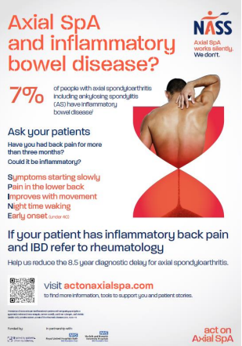
EMMs statistics
40% of people with AAU have Axial SpA
26% of people with axial SpA have AAU
7% of people with axial SpA have IBD
9% of people with axial SpA have psoriasis
For patients presenting with chronic back pain plus an EMM, refer to rheumatology or seek advice and guidance

Slide 6

Axial SpA things to consider
Inflammatory pain
Functional impairment
Onset typically starts late teens early 20’s (average age 26yrs)
Can have lifelong impact and long-term implications if left untreated
Diagnosis is difficult and often delayed

Slide 7
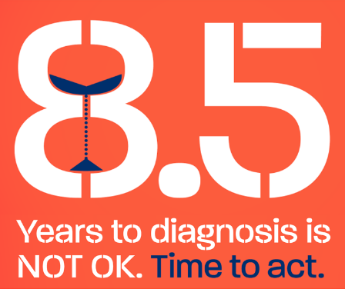

Axial SpA reducing the delay to diagnosis
1 in 200 of the adult population in the UK have axial SpA
Onset typically starts late teens early 20’s (average age 26yrs)
Affects the same number of females and males.
85-90% of people with axial SpA carry the HLA-B27 gene
Notes:
91% of the UK population have never heard of axial SpA

Slide 8

Key signs to consider when assessing women for axial SpA
Presentation in women is often less likely to be in line with the traditional symptoms of axial SpA and requires a more holistic assessment.
Women more often have non-radiographic axial SpA with negative imaging
Women are more likely to have wide spread pain and functional impairment
Women are more likely to have extra musculoskeletal manifestations
Women are more likely to have lower CRP inflammatory markers
Woman are more likely to have negative HLA-B27
Notes:
Slobodin G et al. Clin Rheumatol. 2011;30:1075-1080.
Tourmadre A et al. Arth Care & Res. 2013;65(9):1482-1489
Lee W et al. Ann Rheum Dis. 2007;66:633-638

Slide 9

Impact of delay to diagnosis
Some people report not feeling listened to or believed
People with delayed diagnosis may also suffer from a less favourable response to treatment
Worse outcomes in disease activity, fatigue, function, spinal mobility and radiographic changes to the spine
These individuals may have a higher prevalence of mental health and psychosomatic disorders
59% of people with axial SpA report experiencing mental health problems compared to 25% of those with musculoskeletal conditions overall

Slide 10
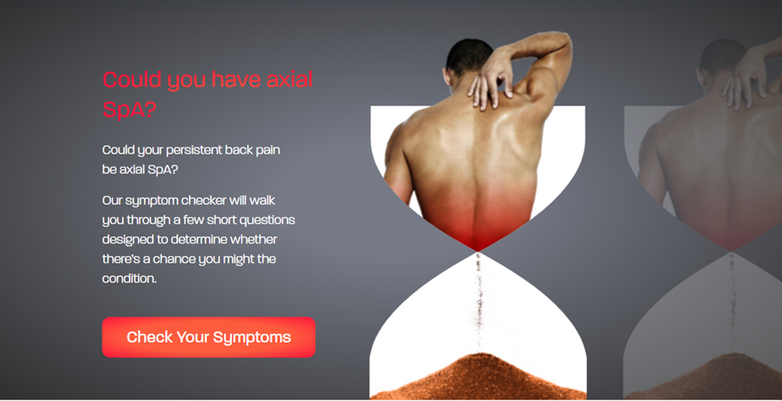

Clinically validated Symptom Checker

Slide 11
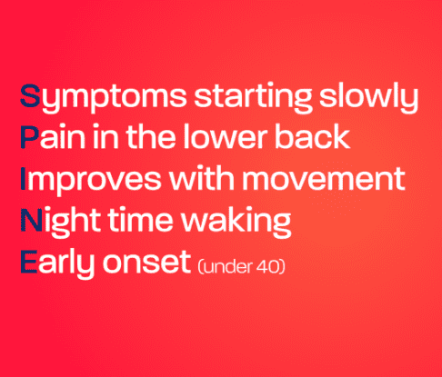
Symptom checker and SPINE acronymn
Inflammatory arthritis effecting spine and Sacroiliac joints.
  Back pain started before the age of 40
  Back pain developed slowly
  Chronic back pain lasting greater than 3 months
  Back stiffness upon waking
  Back pain improves with exercise / movement
  Back pain worse with rest
  Alternating buttock pain
  Regular waking at night
Complete the NASS Symptom Checker: Symptom checker
Notes:
*Sieper J, van der Heijde D, Landewe R, Brandt J, Burgos-Vagas R, Collantes-Estevez E, et al. New criteria for inflammatory back pain in patients with chronic back pain: a real patient exercise by experts from the Assessment of SpondyloArthritis international Society (ASAS). Annals of the rheumatic diseases. 2009;68(6):784-8.
Rudwaleit M, Metter A, Listing J, Sieper J, Braun J. Inflammatory back pain in ankylosing spondylitis: a reassessment of the clinical history for application as classification and diagnostic criteria. Arthritis Rheum. 2006;54(2):569-78.
Calin A, Porta J, Fries JF, Schurman DJ. Clinical history as a screening test for ankylosing spondylitis. JAMA. 1977;237(24):2613-4

Slide 12
MRI in the diagnosis of axial spondyloarthritis
MRI plays a crucial role in diagnosis of axial SpA - especially in nr-AxSpA
Rheumatologists utilise imaging including MRI when making a diagnostic decision
Rheumatologists should request MRI using a spondyloarthritis protocol of the SIJ and whole spine
Rheumatologists should work closely with local MSK radiologists in the interpretation of imaging

Slide 13
BRITSpA 2019 recommendations for acquisition and interpretation of MRI in the diagnosis of axial spondyloarthritis in the UK
Overarching principles
1. The diagnosis of axSpA is based on clinical, laboratory and imaging features
2. Some patients with axSpA can have isolated inflammation of either the SIJs or spine
Recommendations
1. When requesting an MRI for suspected axSpA, imaging of both the SIJs and the spine is recommended
2. T1-weighted and fat-suppressed, fluid-sensitive sequences (including STIR, fat-saturated T2 or Dixon methods) are recommended for suspected axSpA
3. The minimum protocol when requesting an MRI for suspected axSpA should include sagittal images of the spine with extended lateral coverage and images of the SIJs that are in an obliques coronal plan to the joint
4. In the SIJs, the presence of bone marrow oedema, fatty infiltration or erosion is suggestive of the diagnosis of axSpA. The presence of more than one of these features increases the diagnostic confidence of axSpA
5. In the spine, the presence of multiple corner inflammatory lesions and / or multiple corner fatty lesions increases the diagnostic confidence of axSpA
6. In the SIJs and / or spine the presence of characteristic new bone formation increases the diagnostic confidence of axSpA
7. The full range and combination of active and structural lesions of the SIJs and spine should be taken into account when deciding if the MRI scan is suggestive of axSpA or not
Notes:
The aim of the Primary Care champions is to Identify
Timothy J P Bray, Alexis Jones, Alexander N Bennett, Philip G Conaghan, Andrew Grainger, Richard Hodgson, Charles Hutchinson, Maria Leandro, Peter Mandl, Denis McGonagle, Phill O’Connor, Raj Sengupta, Marianna Thomas, Andoni Toms, Naomi Winn, Margaret A Hall-Craggs, Helena Marzo-Ortega, Pedro M Machado, British Society of Spondyloarthritis (BRITSpA), Recommendations for acquisition and interpretation of MRI of the spine and sacroiliac joints in the diagnosis of axial spondyloarthritis in the UK, Rheumatology, Volume 58, Issue 10, October 2019, Pages 1831–1838

Slide 14
NASS resources for clinicians

Slide 15
Notes:
To order posters contact clareclark@nass.co.uk

Slide 16
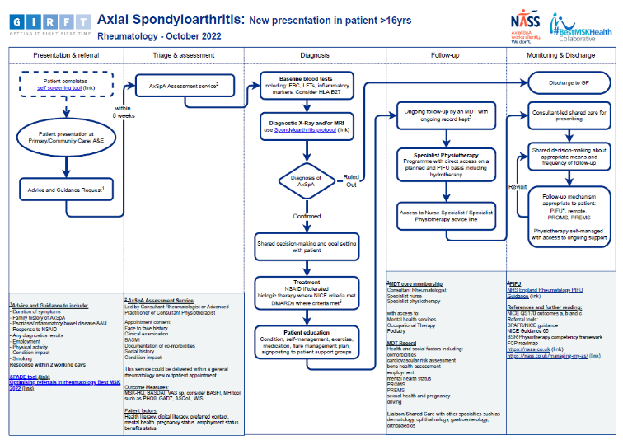
Best MSK / GIRFT axial Spondyloarthritis pathway (England only)
Notes:
Add in details from your local pathway, eg
Advice and guidance option
MRI and bloods prior to referral to Rheumatology
SPADE prior to Rheumatology

Slide 17
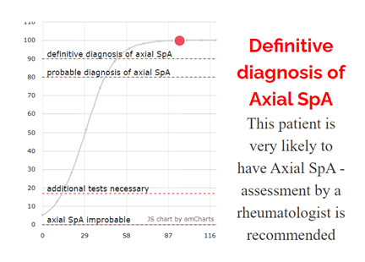
SPADE tool www.spadetool.co.uk
Developed by Dr Raj Sengupta and Team
Inflammatory type back pain
Heel pain (enthesitis)
Peripheral arthritis
Dactylitis
Iritis or anterior uveitis
Psoriasis
Positive family history of axial SpA, reactive arthritis, psoriasis, IBD or anterior uveitis
Good response to NSAIDs
Raised acute-phase reactants (CRP/ESR)
HLAB27
Sacroiliitis shown by MRI

Slide 18



Using IT to alert clinicians to suspected axial SpA
Prof. Raj Sengupta & PRIMIS
  https://www.nottingham.ac.uk/primis/projects/axspa.aspx
  ‘Pop up’ alert and retrospective audit tool with ASAS criteria and SPADE embedded for assessment
  Works on TPP SystemOne with EMIS web in development
  Pilot sites trialling
Dr Toby Wallace & Ardens
  Ardens FCP MSK template
  MSK triage templates for both GP and FCP, updated with ASAS, NICE, SPADE, GIRFT criteria
  Works on TPP SystemOne and EMIS
  Updated templates available

Slide 19
Key takeaways
Axial SpA is common and effects both men and women equally
Negative x-ray does not rule out axial SpA
People with axial SpA may primarily present with an EMM
If the symptom checker and SPADE show high indication of axial SpA despite normal bloods;
  Consider using Advice and Guidance from the Rheumatology department if available
  Refer to rheumatology with your findings and clinical reasoning
Notes:
Local pathway information can be added/tailored here

